Slide 1
Is this house ‘worthy’ to be your home?
Using Regression Analysis to Predict HDB Resale Prices
Valerie Lim
4 Feb 2020
Notes:
Good morning everyone. Today, I’ll be sharing with you my project on using Regression Analysis to predict HDB resale prices

Slide 2
Table of Contents
Introduction
Methodology
Methodology
Outline
Feature Selection
Results
Results
Conclusion
Future Work
Model Performance
Feature Importance
Notes:
I’ll begin by setting up the context and problem statement, before I walk you through my methodology. Next, I’ll dive into the results as well as some interesting insights and recommendation. Lastly, I’ll wrap up with some future directions for this project

Slide 3

Introduction
A house represents the biggest investment
Yet, first time home buyers are often unsure about the
factors that influence prices
‘true’ value of property prices and
Introduction | Methodology | Results | Conclusion | Future Work
Notes:
For most households, a house represents the biggest investment.
For couples who are planning to settle down but couldn’t secure a Built-To-Order flat would have to seek alternatives, such as HDB Resale flats.
Yet, as first-time home buyers, they are often clueless about the market rate of house prices. This could be because there are a lot of factors that could influence house prices. Unless you’re sufficiently well-read about the property market or has done/is doing extensive research, buyers often have imperfect information. As a result, property agent are likely to lead this conversation.
Can buyers be granted with actionable insights so that the balance can be more symmetrical?

Slide 4
Introduction
Goal:
Use property listings to predict prices and grant buyers’ with more power in determining if their desired property is priced at the 'truth' value
Introduction | Methodology | Results | Conclusion | Future Work
Notes:
Yes! That’s the aim of this project: to provide data-driven and valuable guidance to first-time home buyers in determining if their desired property is priced at the 'truth' value

Slide 5
Methodology
Data
collection
Data
Preprocessing
Feature Engineering
Feature Selection
Train & Evaluate Model
Dropped duplicated listings
Imputed ‘missing’ information as 0
Converted categorical variables (e.g. property type, model type) to dummy variables
Age of flat
HDB Towns → HDB Region
Log transformed price
Lasso regression model
Metric:
Mean absolute error,
Root mean squared error
Tools:
Introduction | Methodology | Results | Conclusion | Future Work
Notes:
- I used Beautiful Soup to scrape HDB resale flats from SRX. Each listing has various information, from core information such as property type, name, location, model type to more granular information such as the kind of facilities they have, whether it is a corner unit or renovated etc.
Since the target audience are couples who are searching for a flat, I focused on listings that are 3-room and above
Among the pool of selected listings, there are some duplicated ones which I dropped.
Some listings omitted that other listings provided, and I imputed these missing ones as 0
I converted such variables (e.g. property type, model type) to dummy variables
I created new features such as age from years built for ease of interpretation, and aggregated HDB towns into regions to investigate whether different areas in Sg have an impact on prices.
Feature selection was conducted at various stages of the model building process, which I’ll share in greater detail in the next slide
Finally I built the model using Lasso reg and used mainly Mean absolute error (which is an average error) as my main metric for evaluation

Slide 6
FEATURE SELECTION
Type | Variable |  |  | Reason for Removal |  |  |  | In final model?
 |  |  |  | High correlation | Zero correlation with target | Backward stepwise | Lasso regression
Target | Asking price (log) |  |  |  |  |  |  | ✓
Core | Property Type |  |  |  |  |  |  | ✓
 | Model type |  |  |  |  | Certain Model types | ✓
 | Bedrooms |  |  |  |  |  |  | ✓
 | Per square foot |  |  |  |  |  |  | ✓
 | Area |  |  | ✓
 | Furnish |  |  |  | ✓
 | Land Tenure
 | HDB Town |  |  |  |  |  | ✓
 | HDB Region |  |  |  |  |  | ✓
 | Age
 | Year built |  |  | ✓
Facilities | Jacuzzi, Meeting Rooms |  |  |  | ✓
 | Private pool, Garage |  |  | ✓
 | Air Conditioning Renovated Corner Unit Water Heater Balcony Private Garden Outdoor Patio | Original Condition Hairdryer Bathtub Maidsroom Colonial Building Private Lift Cooker Hob/hood | City View Park/greenery View Sea View Swimming Pool View Bombshelter Walk-in-wardrobe Roof Terrace |  |  | ✓
Introduction | Methodology | Results | Conclusion | Future Work
Notes:
Before building the models:
To avoid multicollinearity, features that were highly correlated were removed. Features that had 0 correlation with target variable was also removed.
After which, features were selected using backward stepwise method. Based on OLS model, features with p-values above 0.05 were removed
Lasso regression was also used for feature selection. Features that had coefficients of 0 were removed.
Finally, the final features are property type and per square foot and number of bedrooms.

Slide 7
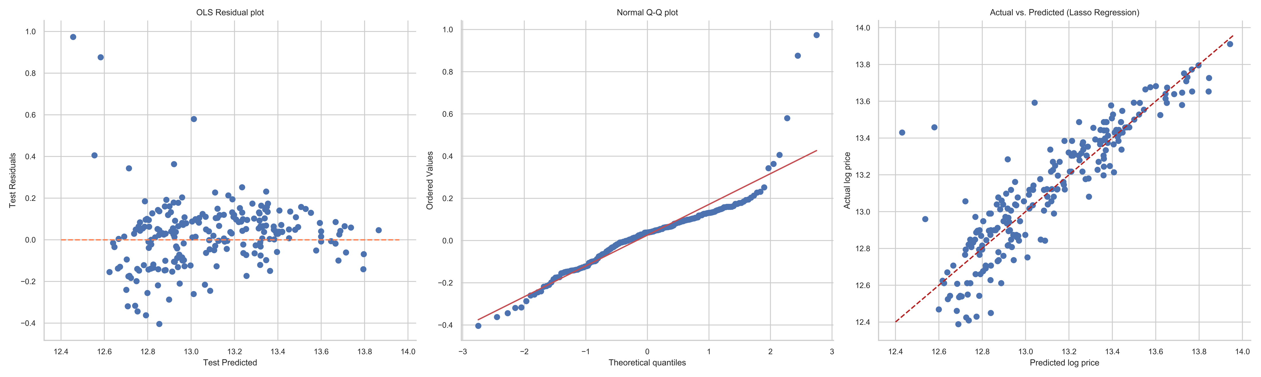
Results
MODEL PERFORMANCE
MEAN ABSOLUTE ERROR
0.10
(~$ 52K)
ROOT MEAN SQUARED ERROR
0.16
(~$ 74K)
Introduction | Methodology | Results | Conclusion | Future Work
Notes:
Using this model, the mean absolute error is about 0.1. after reversing the log transformation, this error is equivalent to $52k, which means buyers using this tool can expect roughly that much wiggle room in determining housing prices based on the features mentioned earlier.
Rmse: Since the errors are squared before they are averaged, the RMSE gives a relatively high weight to large errors. This means the RMSE should be more useful when large errors are particularly undesirable.
Plot actual log prices against my predicted log prices. The red line represents a perfect model where my actual prices is equal to =my predicted prices. My linear reg model appears suitable for the data, except the some of these outliers – where the model predicted a lower price than actual.
Based on these data points, the model suggested property type bigger than 5-room flats and PSF to be sig predictors. But other features could be more suitable in predicting housing prices for these data, so the model can’t predict these flats accurately.

Slide 8
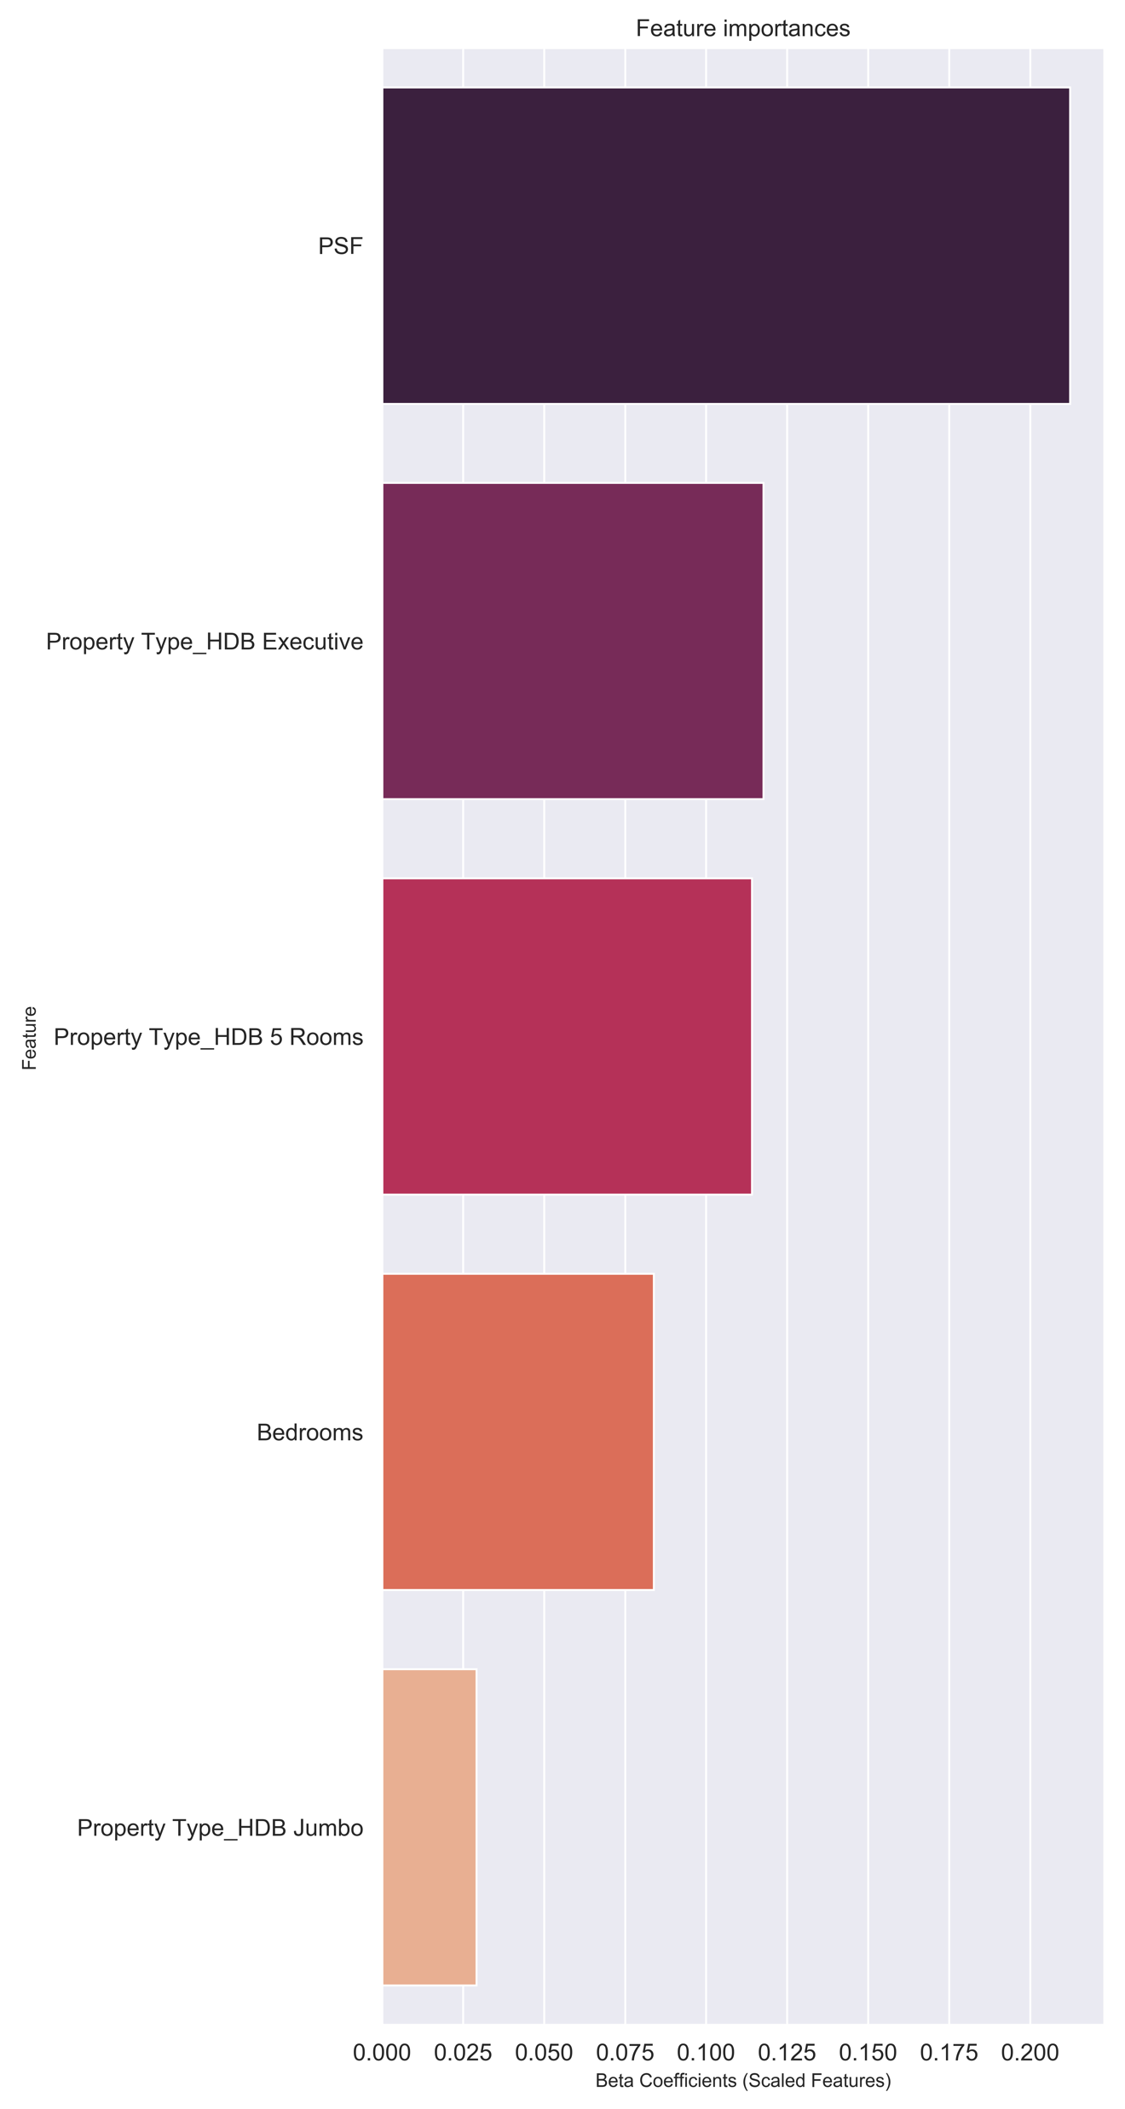
Results
Increase Price (log):
Per square foot is the strongest predictor of price
- Every 1 unit ↑ in PSF, prices ↑ by $61k
FEATURE IMPORTANCE
Introduction | Methodology | Results | Conclusion | Future Work
Notes:
To best understand how the model works, let’s dive into the features. The plot below shows the relative importance of each feature
The strongest positive predictors is per square foot. property type.
Model intercept = 13.12
For 1 unit increase in PSF, price increases by 61k

Slide 9
Results
FEATURE IMPORTANCE
Increase Price (log):
2. Property type
as compared to 3-room flats,
Executive flats ($55k more)
5-room flats ($55k more)
Jumbo flats ($51k more)
Introduction | Methodology | Results | Conclusion | Future Work
Notes:
Followed by property type
- An executive flat and 5-room flat increases price by 55k more than a 3-room flat
- A jumbo flat increases price by 51k more than a 3-room flat

Slide 10
Results
10
FEATURE IMPORTANCE
Increase Price (log):
3. Number of bedrooms
- Every additional bedroom ↑ prices by $54k
Introduction | Methodology | Results | Conclusion | Future Work
Notes:
Lastly bedrooms. For every additional bedrooms, price increases by 54k

Slide 11
11
Conclusion
There are different types of HDB houses you can call home
If you need a bigger living space and have more budget:
For a relatively cheaper house:
A 3-room flat
Smaller per square foot
A 5-room, jumbo or executive flat
1
2
Introduction | Methodology | Results | Conclusion | Future Work
Notes:
In conclusion, there are different types of HDB houses you can call home.
With the above insights, this tells us that if you are looking for something that is relatively cheaper, you can consider a simple 3-room flat with smaller PSF
If you need a bigger living space and have more budget, a 5-room, jumbo or executive flat

Slide 12
Conclusion
There are different types of HDB houses you can call home
Peripheral factors don’t influence prices as much as core features
3
But they could matter based on individuals’ preferences
Introduction | Methodology | Results | Conclusion | Future Work
Notes:
Lastly, Aesthetics factors (e.g. sea view, renovated, corner unit) are not as significant in determining prices as core features (e.g. property or model type); But they could matter based on individuals’ preferences

Slide 13
Future Work
Collect more data, from multiple sources.
Retrieve actual purchasing prices from ERA
Create additional features e.g. distance from business districts – Central Business District, Mapletree Business District, Jurong Lake District
Apply clustering algorithm(s) on features before performing feature selection
Introduction | Methodology | Results | Conclusion | Future Work
Notes:
Current model has still a lot of room for improvement. To increase the accuracy of prediction, I can collect more data, as this results is based on 1000 data points. Having more listings would lower the MAE.
The current source of data is limited to SRX. For a more comprehensive analysis, I could scrape from multiple property market websites such as Propertyguru, 99.co
However, relying on data from property portals may be biased as agents may hike up prices to earn a larger share of the pie. For an even more accurate analysis, I could gather the actual purchasing prices from ERA.

Slide 14
Thank you!

Slide 15

Valerie Lim
github.com/valerielimyh
medium.com/@valerieeelimyh
valerieeelimyh@gmail.com

Slide 16
Questions?

Slide 17
Appendix

Slide 18
Model Comparison
Linear Regression Model Performance Comparison
Model Type |  | Adjusted R² | RMSE | MAE | RMSE (exponential) | MAE (exponential)
Lasso Regresison | Validation | 84% | 0.12 | 0.10 | 60k | 46k
 | Test | 77% | 0.15 | 0.10 | 74k | 52k
Ordinary Least Square | Validation | 84% | 0.12 | 0.10 | 61k | 45k
 | Test | 84% | 0.15 | 0.10 | 72k | 50k

Slide 19
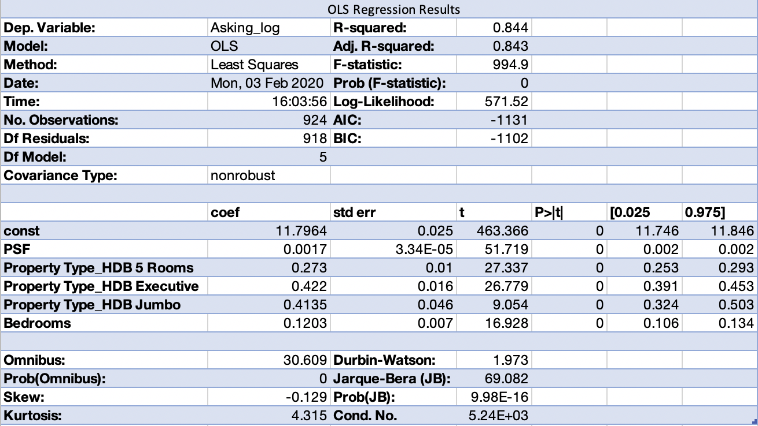
OLS summary statistics

Slide 20
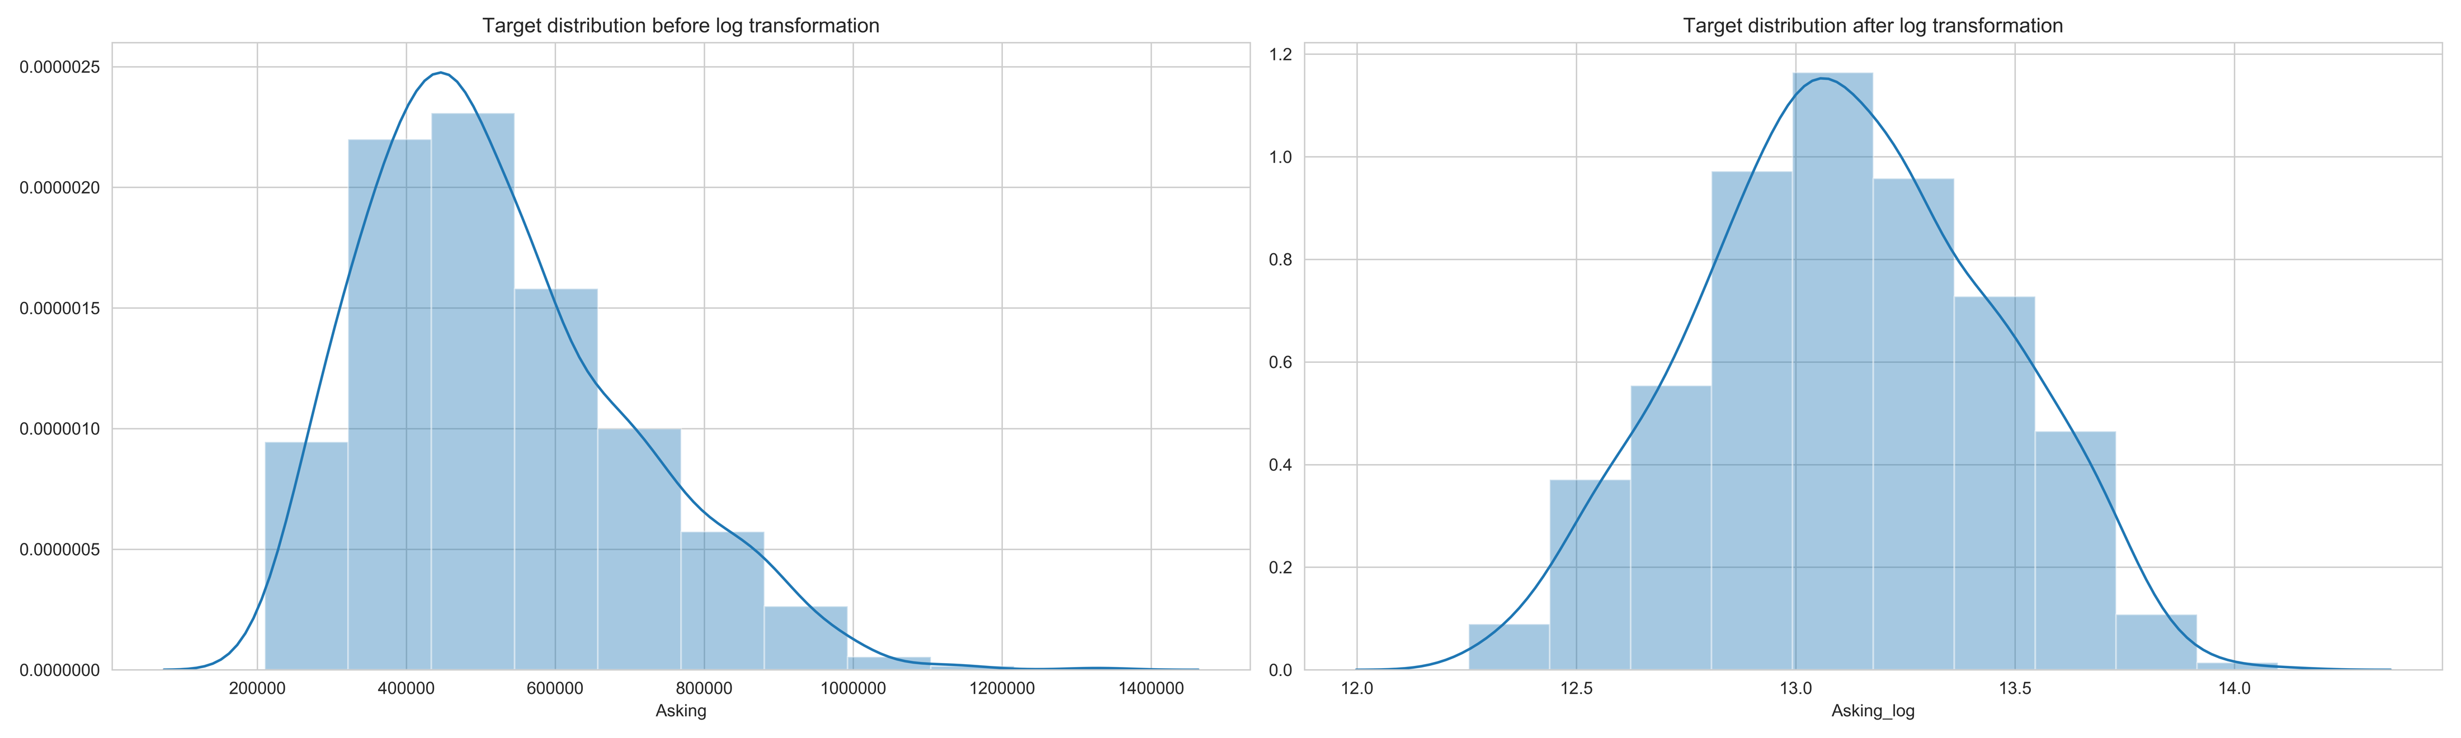
Feature engineering: Log Transforms of target variable

Slide 21
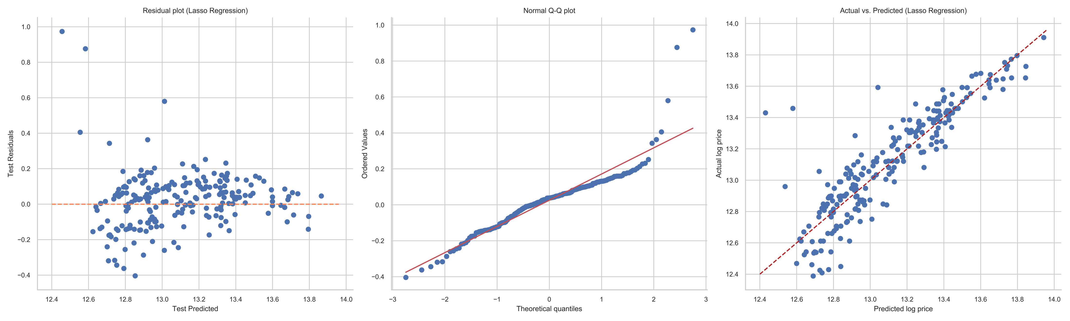
Assumption 1: regression is linear in parameters and correctly specified

Slide 22
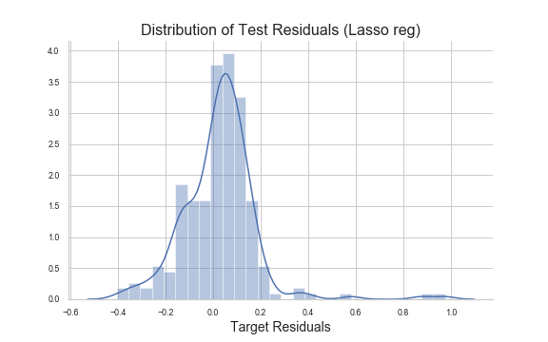
Assumption 2: Residuals should be normally distributed with zero mean

Slide 23
Assumption 3: error terms must have constant variance

